Slide 1
ANALYSIS OF RESTAURANTS IN FARIDABAD
Coursera Capstone Project

Slide 2
Introduction
This project would be of interest to:
Those trying to start a new business.
People wishing to evaluate competition.
Investors evaluating a proposal.

Slide 3
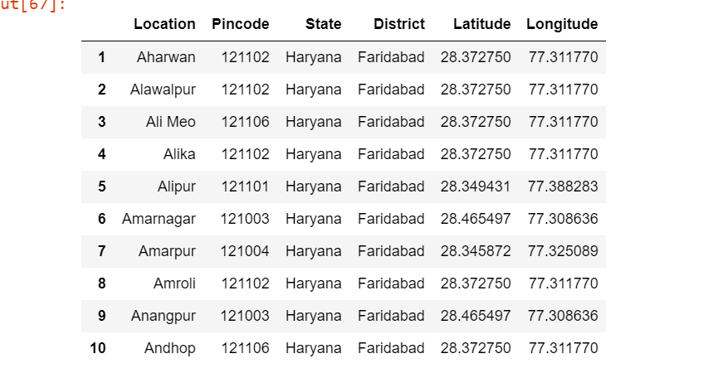
Data Sourcing
The data was sourced via:
https://www.mapsofindia.com/pincode/india/haryana/faridabad/
This gave the pincodes to pinpoint the venues
Location via Foursquare:
Texplore venue information for each neighborhood in the FARIDABAD city.
This data was put into a database and longitude, latitude data was added to it via “geopy”

Slide 4
Methodology
Data was collected with relevant values in database.
The data was visualised using folium.
One-hot encoding and standardization was done for data processing.
K-means was applied on this data.
K was defined via Elbow method (Equal = 2)

Slide 5
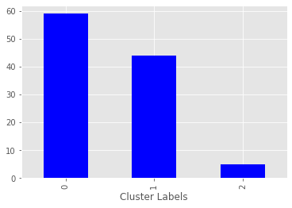
Results
We are able to define 3 sections as per the data:
Cluster 1: Neighborhoods where Fast Food Restaurants aren't a common venue
Cluster 2: Neighborhoods where Fast Food Restaurant are a common venue
Cluster 3: Neighborhoods where Fast Food Restaurant are the most common venue

Slide 6
Discussion
The fast-food restaurants' being the most common venue is observed in cluster 3, followed by moderate density in cluster 2 and none in cluster 1.
Therefore, when choosing a neighbourhood to open a fast-food restaurant, it is advisable to consider locations in Cluster 0 and 1 because of the lack of competition and the ability to conquer the market. It is also important to be centrally located in the city to cover the maximum radius of potential customers.

Slide 7
Conclusion
The data is not exhaustive, but it allows us to identify the areas most feasible to set up shop.
The application of data science techniques gives a good accurate start point to the research for location.
Based on the Clusters formed it would be a good idea to open a restaurant in Clusters 0 & 1 since the other clusters already have fast-food restaurants in their vicinities. Also, clusters 0 & 1 have many restaurants in the vicinity (Pizza restaurants, cafe, coffee shop, Indian restaurants) so one will be able to attract a good crowd. Travel and supplies will also affect the ability to run the store.

